Slide 1
PALAZZO ITALIA
Renovation of Egg Meeting Room P04
HT Campus Development & Facility Management Department

Slide 2
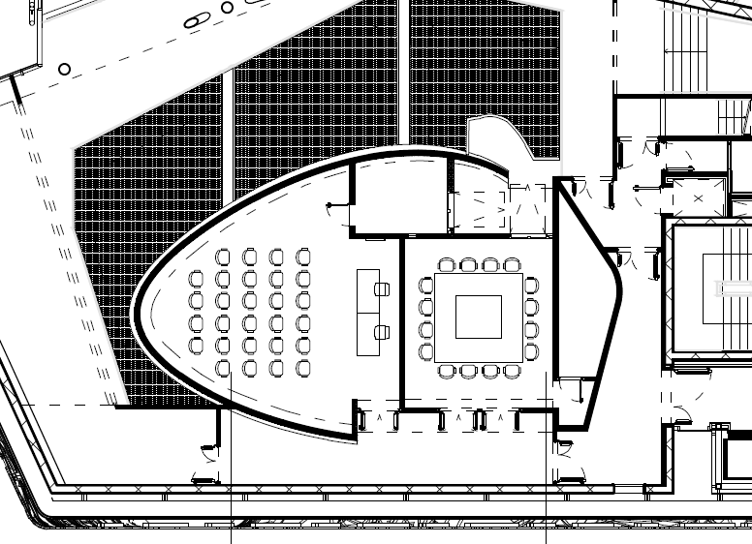

Renovation Egg Meeting Room P04
PRE

Slide 3
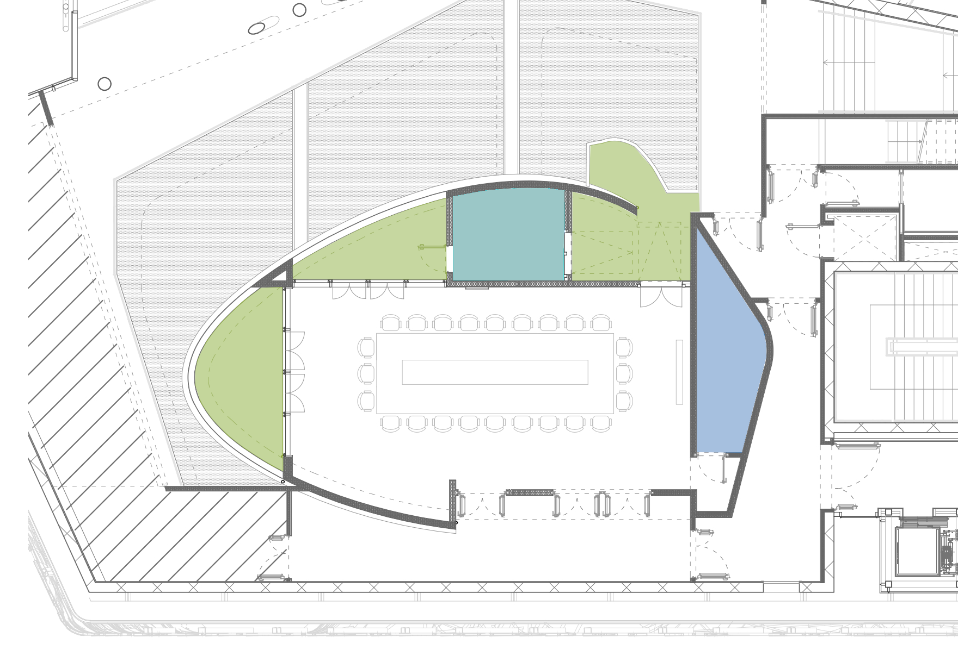
Renovation Egg Meeting Room P04
B
POST
C
F
A
A
Window to Door opening into the wall
C
E
B
Existing terrace made usable
D
C
New terraces
D
Doors with function of smoke-out
E
Storage and archive
F
Technical Room with electrical riser

Slide 4
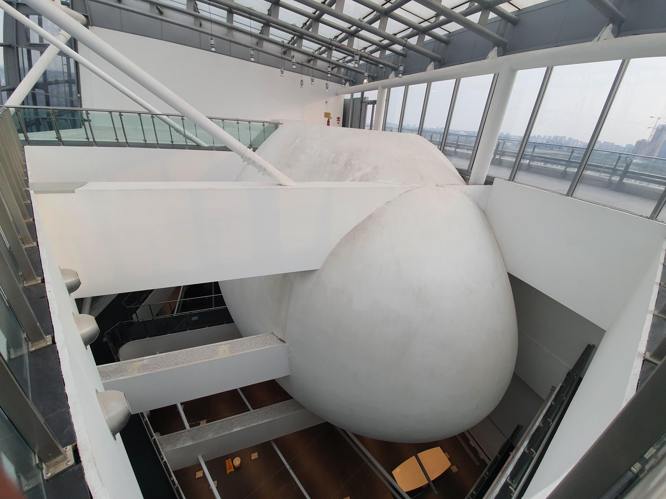
Egg Meeting Room
P04 from outside
PRE

Slide 5
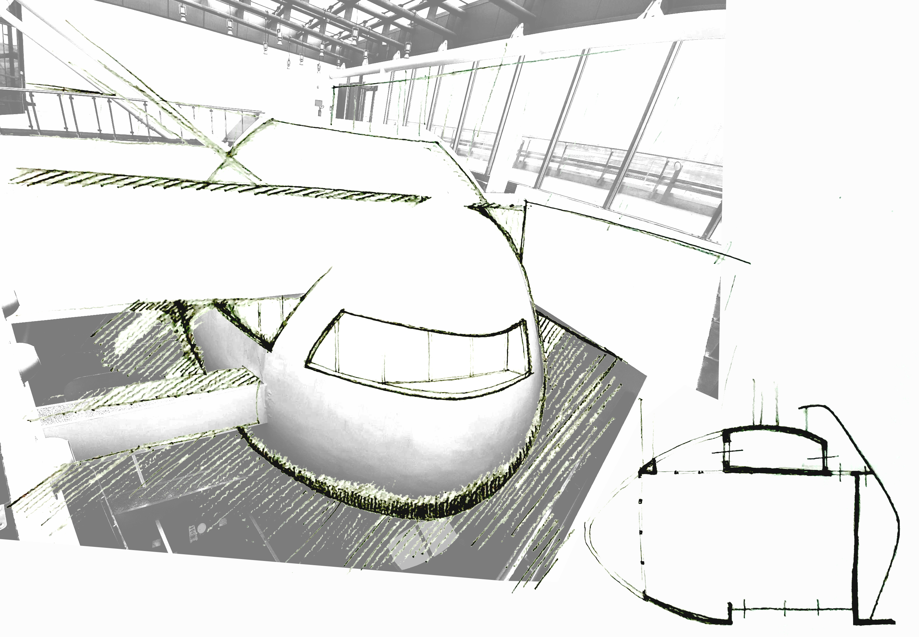
Egg Meeting Room
P04 from outside
POST

Slide 6
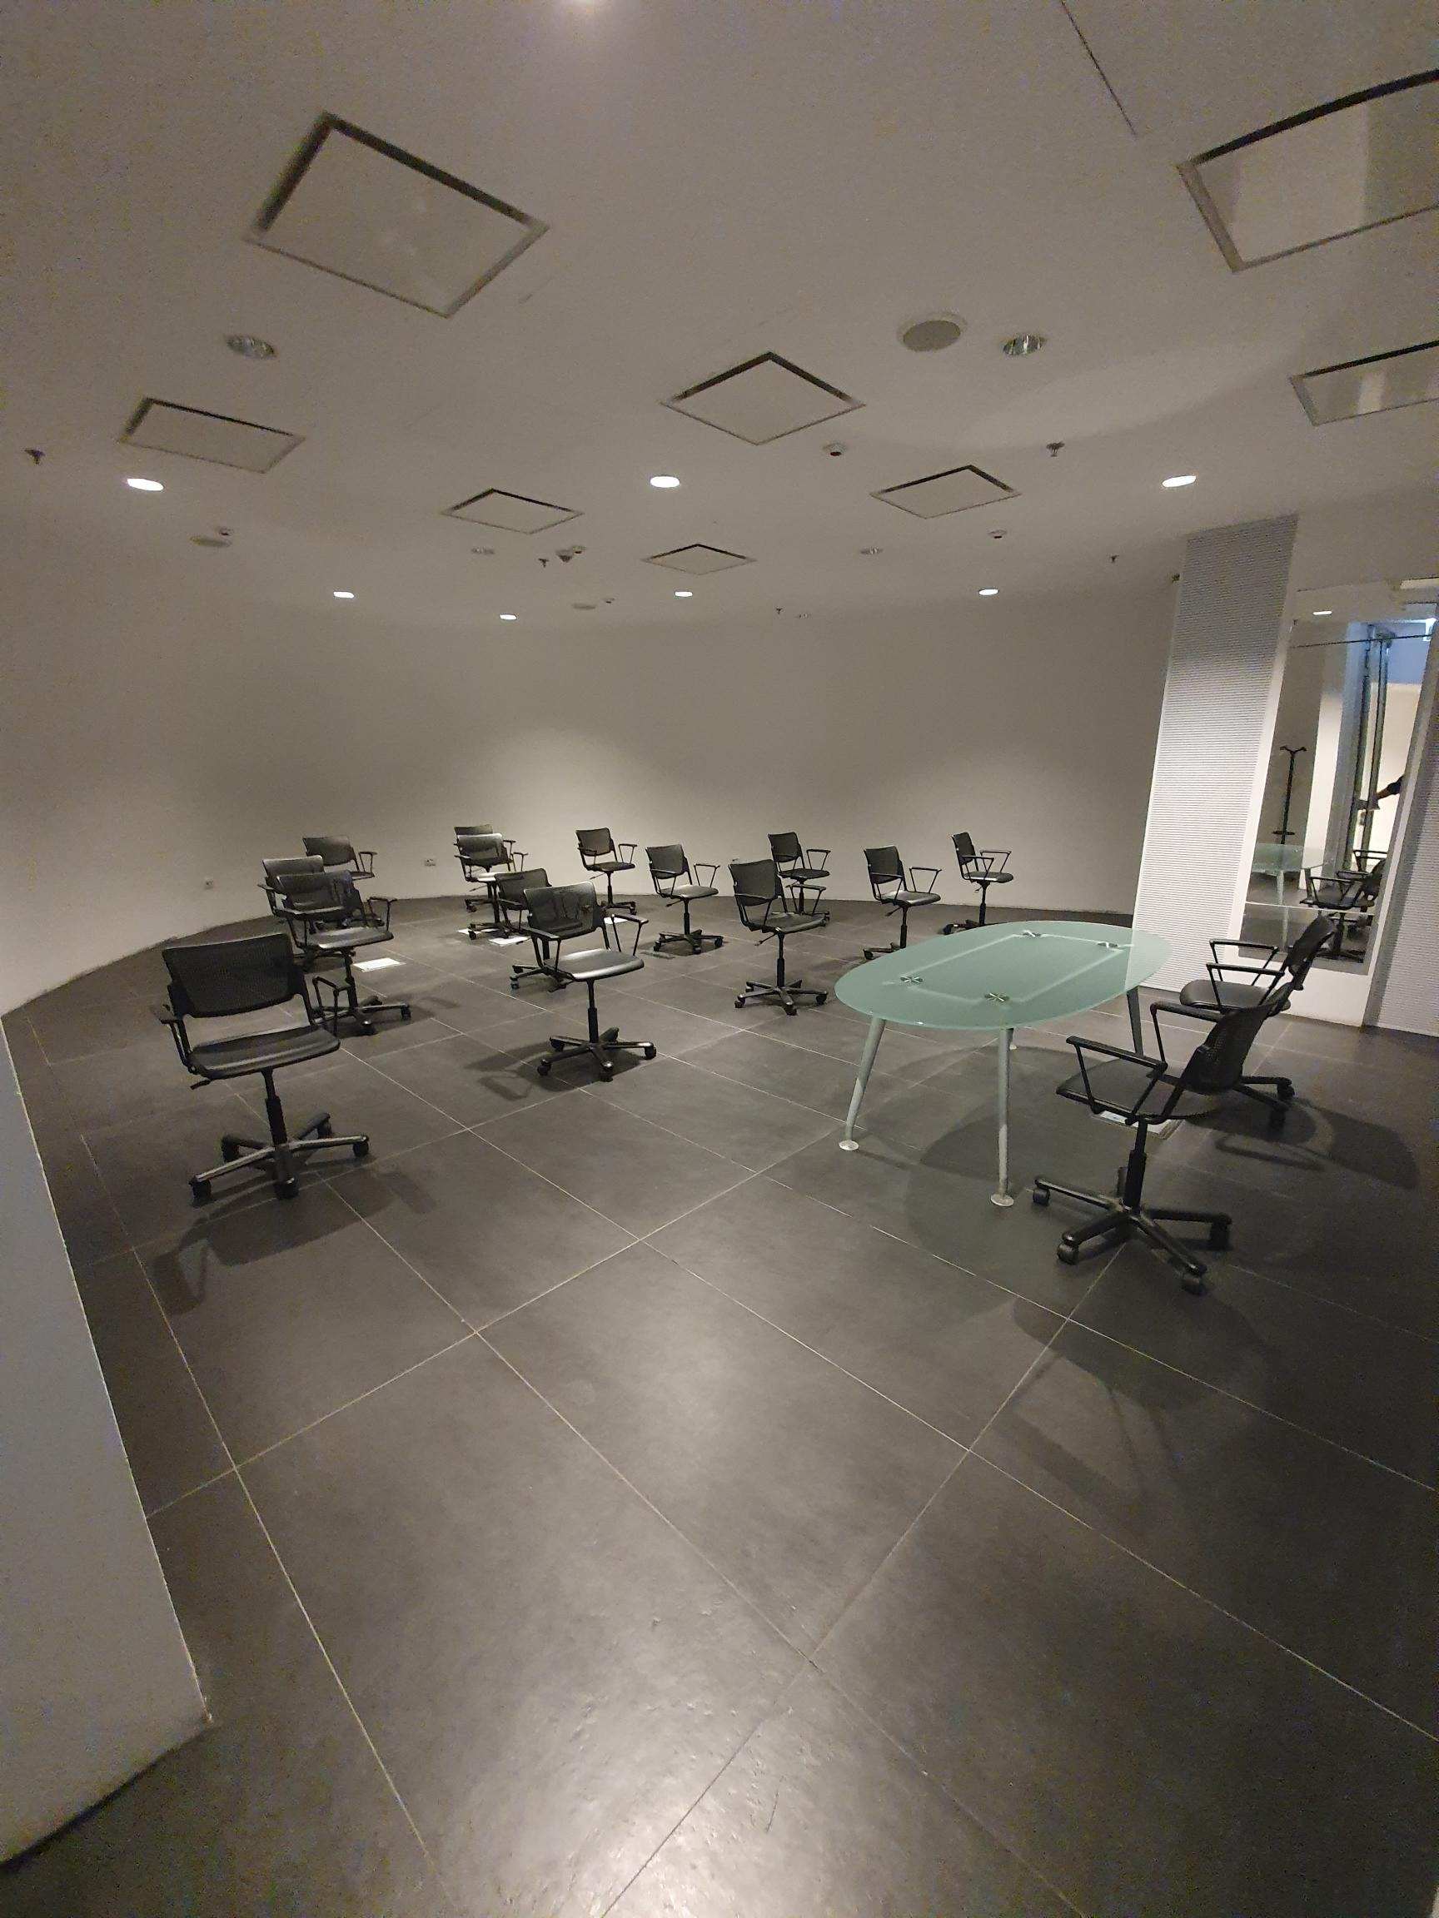
Egg Meeting Room
P04 from inside
PRE

Slide 7
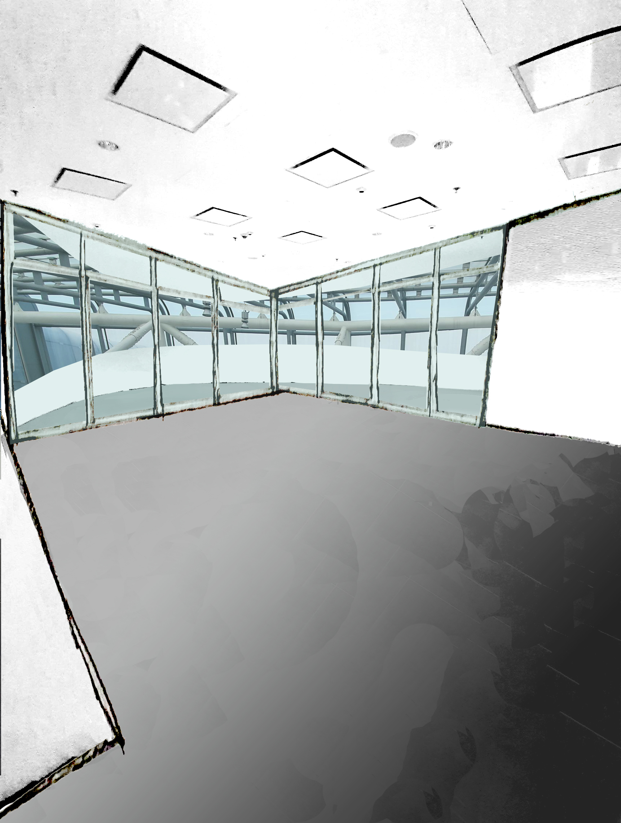
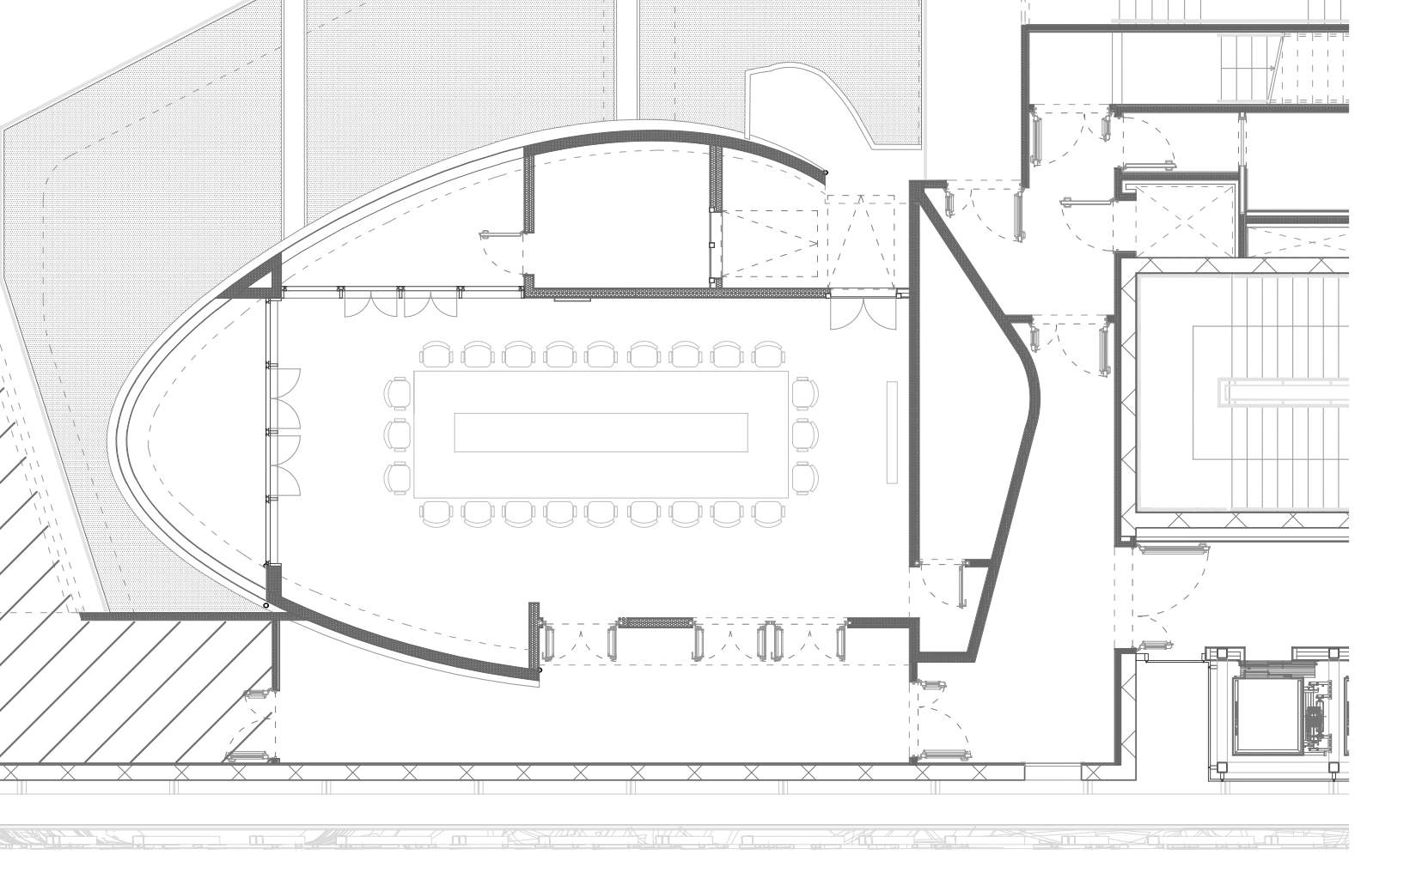
Egg Meeting Room
P04 from inside
POST

Slide 8
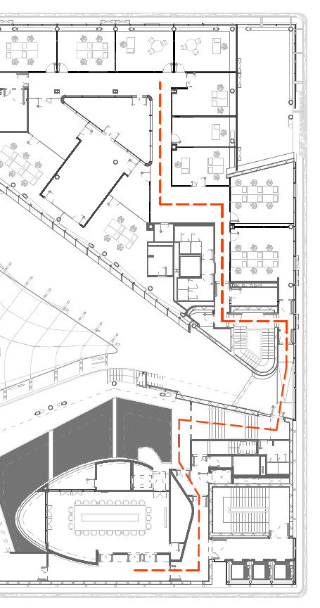
Egg Meeting Room
P04
PRE
PATH CRITICAL ISSUES
1) Stairwell Crossing
2) Rainwater Infiltration
3) Outside Space Crossing
* Technical Room with Racks and Electrical Panels.
*
1
3
2

Slide 9
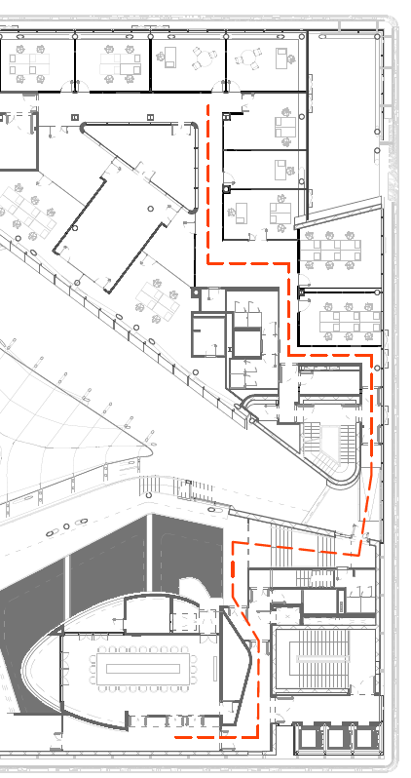
Egg Meeting Room
P04
POST
PATH CRITICAL ISSUES
1) Stairwell Crossing
Moving Office Wall and Corridor Creation
2) Rainwater Infiltration
Resolution in progress
3) Outside Space Crossing
Closing Outside Space
* Technical Room with Racks and Electrical Panels.
*
1
3
2

